Slide 1

Movies recommendation system.
Group 10.

Slide 2
Project LAYOUT
Business understanding
Data understanding
Data preparation
Exploratory data analysis
Modeling evaluation

Slide 3
Business understanding
Business overview
Introduction
Problem statement
Project objectives

Slide 4
Project objectives.
Develop a recommendation system that leverages user data and movie information to provide personalized movie recommendations.
Implement different recommendation techniques, such as collaborative filtering and content-based filtering, to ensure a diverse and accurate set of movie recommendations.
To develop a movie recommendation system based on movie attributes, user ratings, and user interactions.

Slide 5
Metrics of success
Precision
Our model should have a precision of 0.6 and above.
Recall
Our model should have a recall of 0.6 and above.
RMSE
Our model should have an RMSE of 0.4 and below.

Slide 6
Data understanding.
TMDB is a popular database that provides comprehensive information about movies, that contains the following titles, release dates, genres, cast and crew information. Credit information is given as well about the cast and crew information whereby the cast and crew are involved in each movie. With the combination of the datasets, we gain valuable insights and perform various analyses related to the movie industry.

Slide 7
Data preparation.
Identified and dealt with missing values for columns.
Identified and dropped duplicates.
Checking and handling of outliers.
Checking and dealing with null values.

Slide 8
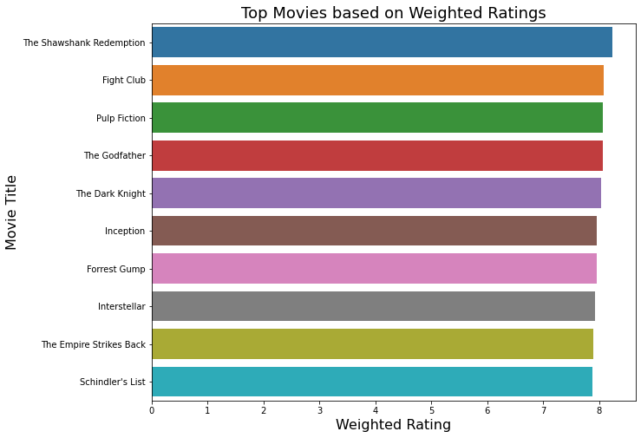
Exploratory data analysis (eda) Most popular movies.
This analysis shows the top movies, based on weighted ratings.

Slide 9
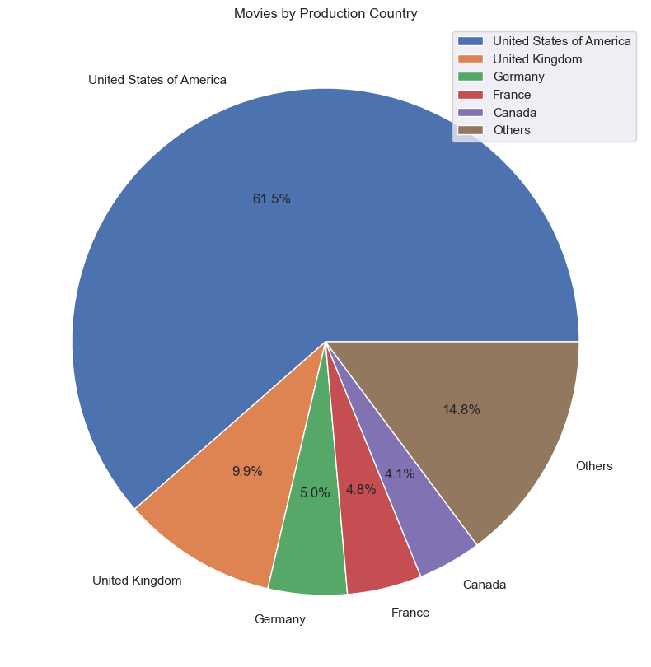
Distribution of Movies based on Country of Production
Based on this analysis, we conclude that majority of the movies (61.5%) were produced in the United States of America.

Slide 10
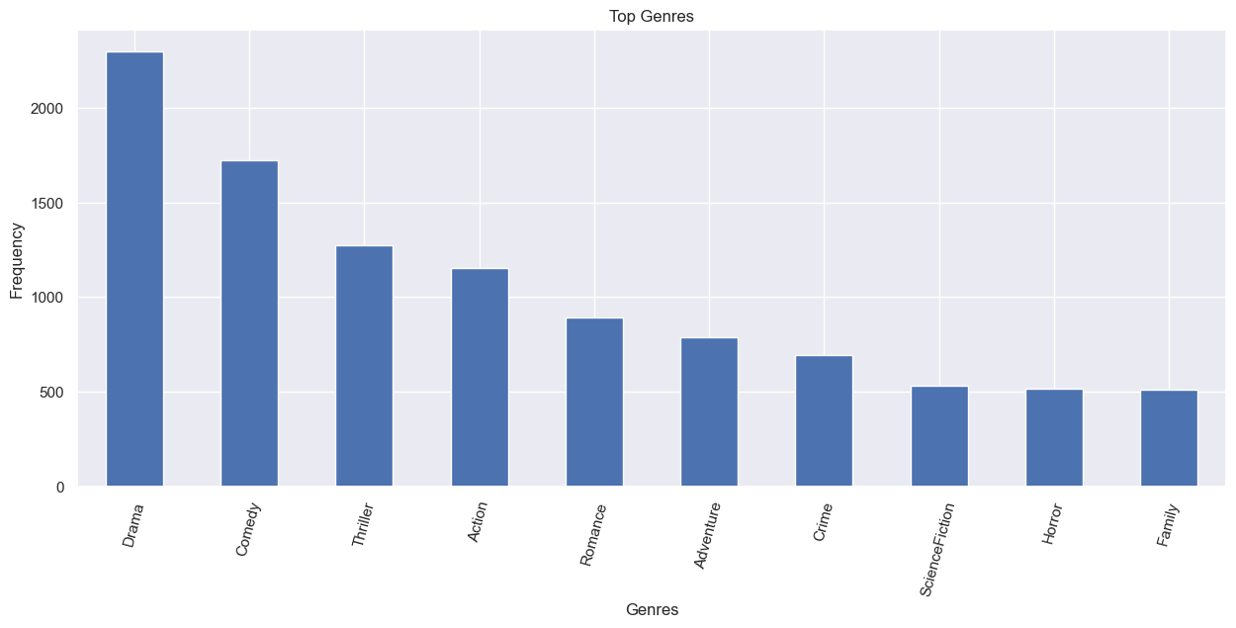
Top Genres
Based on this analysis, we found Drama to be the genre with the largest number of movies.

Slide 11
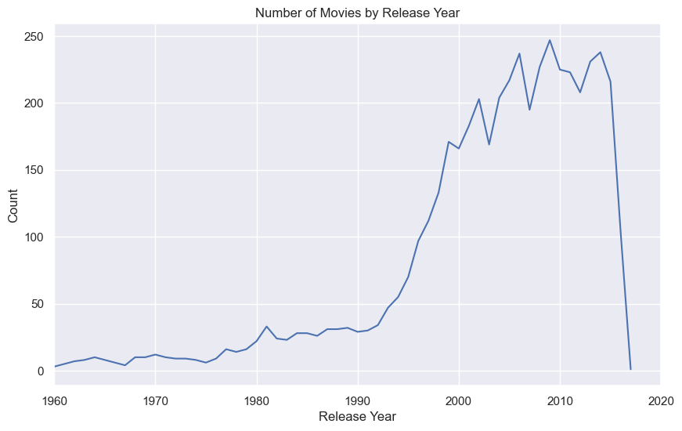
Distribution of movies released over the years.
Based on this analysis, majority of the movies were released between the years 2000 and 2020.

Slide 12
Recommendation systems.
We created four recommendation systems:
Demographic recommendation based on popularity.
Content based.
Collaborative based recommendation.
Hybrid recommendation

Slide 13
1 ) Demographic Recommendation based on Popularity.
For this recommender, we sort the movie/credits based on ratings and display the top movies. We therefore:
Create a metric to score or rate the movies.
Calculate the score for each movie.
Sort the scores and recommend the highest-rated movie to the users.
Implement the formula: Weighted rating (WR) = (vv+m.R) / (v+m)

Slide 14
2. Content based RECOMMENDATION SYSTEM
For this recommendation system, we build an engine that shows the similarity between movie based and the metrics new_dataframe_filtered. Secondly, this will be in two segments :
Movie Overview.
Movie Cast , Keywords and Genre.

Slide 15
3) Collaborative Based Recommendation
This allows for coincidental recommendations; that is, collaborative filtering models can recommend an item to user A based on the interests of a similar user B.

Slide 16
4) Hybrid Recommendation
The hybrid recommendation system combined the previous 3 recommendation techniques, to provide more accurate and personalized recommendations. It is designed to overcome the limitations of individual recommendation techniques and to improve the overall quality of recommendations.

Slide 17
CONCLUSION
In conclusion, the recommendation system serves as a valuable tool in the movie industry to address the challenge of content navigation and provide personalized movie recommendations. By understanding user preferences, leveraging similarities between users, and utilizing movie features, the system aims to enhance the user experience, increase engagement, and ultimately contribute to user retention on the platform.

Slide 18

Group members.
Taylor Musa.
Edna Wanjiku.
Ian Macharia.
Dorine Langat.
Samwel Muiru.
Brian Nyagah.

Slide 19

Thank You

